Slide 1







Slide 2


Bridging the Colors: Aligning Service Programs to Housing Pathways

Slide 3

MHC Programs Crosswalk 2026
Housing Development & Housing Services

Slide 4



Outline
Housing
Services
Programs
Notes:
Participants will walk through MHC programs to learn how they can be layered to support housing stability, dive into the deeper target requirements, and learn practical steps for accessing available resources. By the end of the session, attendees will better understand how coordinated partnerships and aligned funding streams can create stronger pathways to long-term housing success.

Slide 5




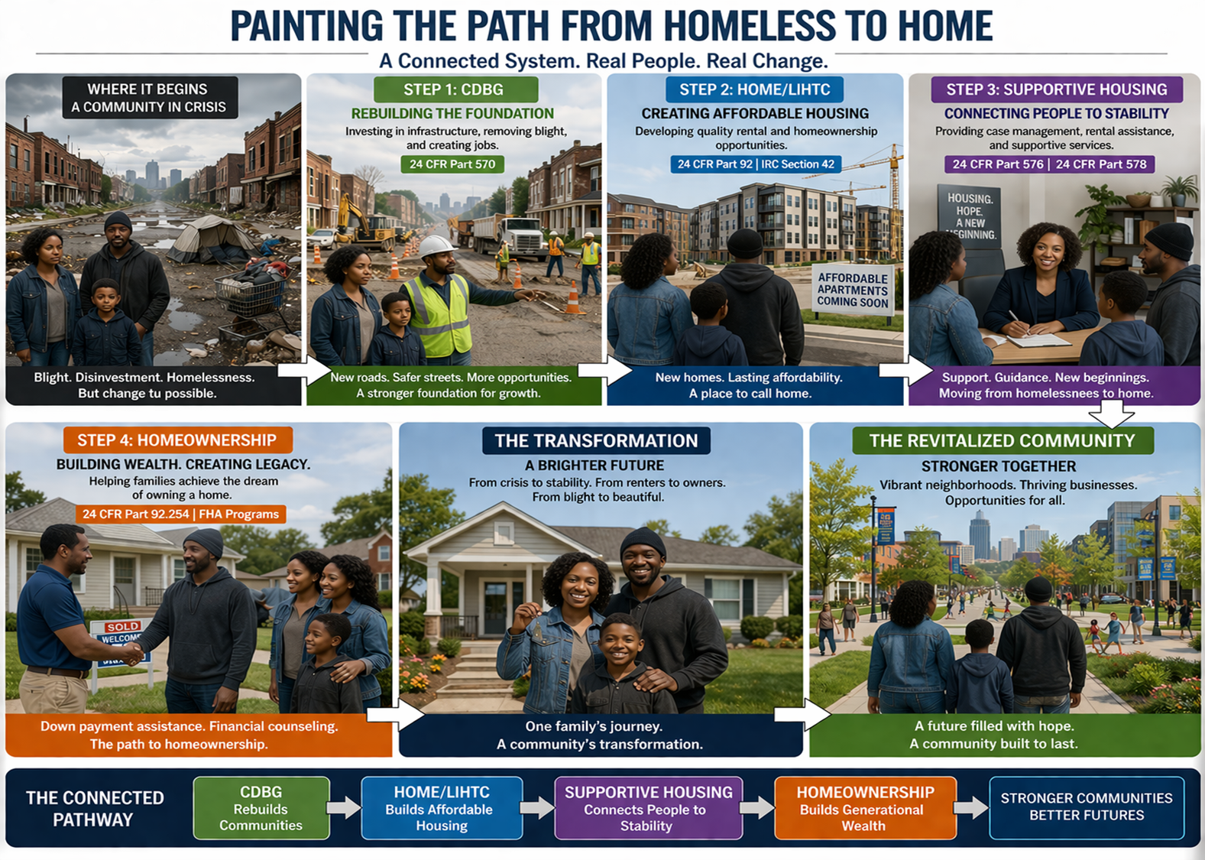

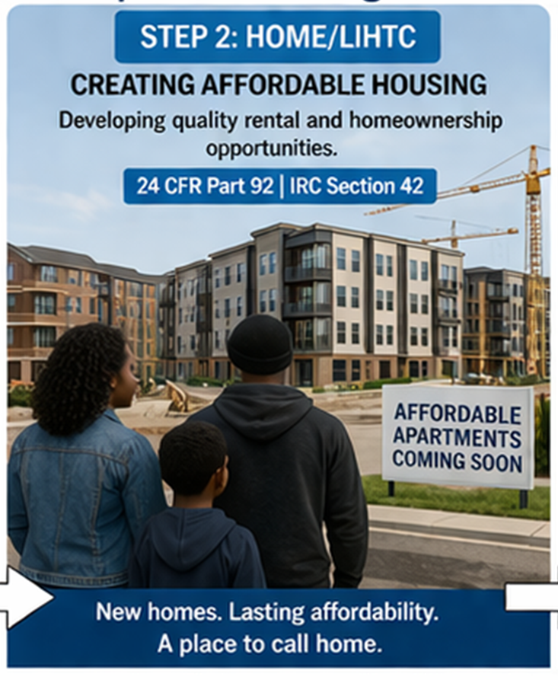

Notes:
This session will focus on Supportive Services through community housing support and its involvement in this entire process and how it creates a path from homelessness to home.

Slide 6
Connecting the Pathway
CDBG
Rebuilds Communities and Creates Jobs
HOME/
HTF
Build Affordable Housing
Supportive Services
Connects People to Stability
Homeownership
Builds Generational Wealth
Stronger Community
Notes:
This session will focus on Supportive Services through community housing support and its involvement in this entire process and how it creates a path from homelessness to home.

Slide 7
MHC Programs

Slide 8
Housing Tax Credit
Priority Population
  Special Needs: Elderly, persons 62 years of age or older, or 55 years of age or older.
  MAOI: Individuals with a serious mental illness (SMI) and are:
      Existing State Hospital
      Has exited a State Hospital in the last 2 years
      Are unstably housed.
  Veterans: who are eligible for VA benefits.

Slide 9
Housing Tax Credit
Household Income and Deeper Target
  General Tax Credit
    Household income is capped at 60% AMI
  Deeper Target
    15% of units for households with income at 30% AMI
Partner with Experience Service Providers

Slide 10
Deeper targeting proposed language
Page 2, Item #4 of the Executive Summary
  Applicants agree to prioritize referrals from an approved MHC housing service provider (as listed in “Addendum L”). A Letter of Commitment between the owner, property manager, and the housing service provider must be included in the application. The Letter of Commitment must include the development’s commitment to set aside units to persons on the housing service provider’s waitlist first. The Letter of Commitment must also include the housing provider’s commitment to provide temporary rental assistance, case management, and other supportive services to persons placed at the development for no more than twenty-four (24) months.

Slide 11
HOME
The HOME Investment Partnership Program, "HOME Program", provides safe, decent, affordable housing for very-low and low-income citizens. The HOME Program is governed by 24 CFR Part 92 and other federal cross-cutting regulations. The activities funded by the HOME Program include homebuyer assistance, homeowner rehabilitation, substantial rehabilitation of multi-family rental units, and new construction of multi-family rental units.

Slide 12
Housing Trust Fund (HTF)
Address the affordable rental housing needs for extremely low and very low-income households, while giving priority to projects that address critical housing needs with an emphasis on the prevention, reduction, and expansion of permanent housing opportunities for persons experiencing homelessness and persons with serious mental illness (SMI).

Slide 13
HOME/HTF
Priority Population
  Homeless
  30% AMI (HTF)
  SMI
  Reentry
  Household income capped at 60% AMI

Slide 14
Five Benefits housing Services providers
Access to the target population
Documentation
Case Management
Financial Support
Stability Planning

Slide 15



Housing Supportive Services Programs
HOME-ARP Supportive Services & TBRA
Emergency Solutions Grant (ESG)
Housing Opportunities for Persons with AIDS (HOPWA)
CHOICE (MAOI)

Slide 16
Emergency Solutions Grant (ESG)
The ESG program provides outreach, shelter, rapid re-housing, homelessness prevention and related services to persons experiencing homelessness or persons in danger of becoming homeless throughout the state. This program is specifically designed to be the first step in a continuum of assistance which will enable homeless individuals and families to move toward independent living as well as prevent future homelessness.

Slide 17
ESG
Eligible applicants
  RRH
    Homeless
  HP
    30% AMI
    At risk of homelessness

Slide 18
Housing Opportunities for Persons with AIDS
(HOPWA)
The HOPWA funds may be used for a wide range of housing, social services, program planning, and development costs. These include, but are not limited to, the acquisition; rehabilitation; or new construction of housing units; costs for facility operations; rental assistance; and short-term payments to prevent homelessness. An essential component in providing housing assistance for this targeted special needs population is the coordination and delivery of support services. Consequently, HOPWA funds also may be used for services including (but not limited to) assessment and case management, substance abuse treatment, mental health treatment, nutritional services, job training and placement assistance, and assistance with daily living.

Slide 19
HOPWA
Eligible applicants
  HIV+ &
  Up to 80% AMI

Slide 20
HOME-ARP
To address the need for homelessness assistance and supportive services, Congress appropriated ARP funds to be administered through HOME to perform four activities that must primarily benefit qualifying individuals and families who are homeless, at risk of homelessness, or in other vulnerable populations.
  Rental Development
  TBRA
  Supportive Services
  NCS

Slide 21
HOME-ARP
Eligible Applicants/Qualifying Populations (QP)
  QP1- Homeless
  QP2- At Risk of Homelessness 30% AMI
  QP3- Victim of Domestic Violence
  QP4- All other unstably housed populations.

Slide 22
CHOICE
A Partnership between Mississippi Home Corporation, Mississippi Department of Mental Health, Mississippi Division of Medicaid, and Mississippi's Community Mental Health Centers. CHOICE provides rental assistance to make housing affordable for individuals with serious mental illness (SMI). Community Mental Health Centers provide services appropriate to the individual based on their individual needs.

Slide 23
CHOICE
Individuals with a Serious Mental Illness (SMI)
and
Meeting one of the 3 CHOICE Priorities

Slide 24

Program Crosswalk

Slide 25
Deeper target 30% AMI

Slide 26
Notes:
Notes:
Housing Tax Credit target populations may qualify for one or more homeless housing assistance programs if they are determined eligible. See the section on eligible applicants.
Housing Tax Credit properties must comply with the relevant Housing Tax Credit regulations. If homeless housing assistance programs are used at a Tax Credit property, the more restrictive program regulations must be followed.
Developers should partner with community agencies or nonprofits that serve the population to help with marketing and outreach. See the list of funded agencies.
HOPWA and HOME-ARP are the only programs that allow funds to be used for services and construction development.
HOPWA can provide services to individuals with HIV and household incomes up to 80% AMI.

Slide 27
Notes:
Notes:
Services are provided to eligible applicants based on the availability of the grant. See the section on Eligible Applicants and the list of funded agencies to identify resources in your area.
The list of funded service providers is as of 2025 and may change in 2026.

Slide 28
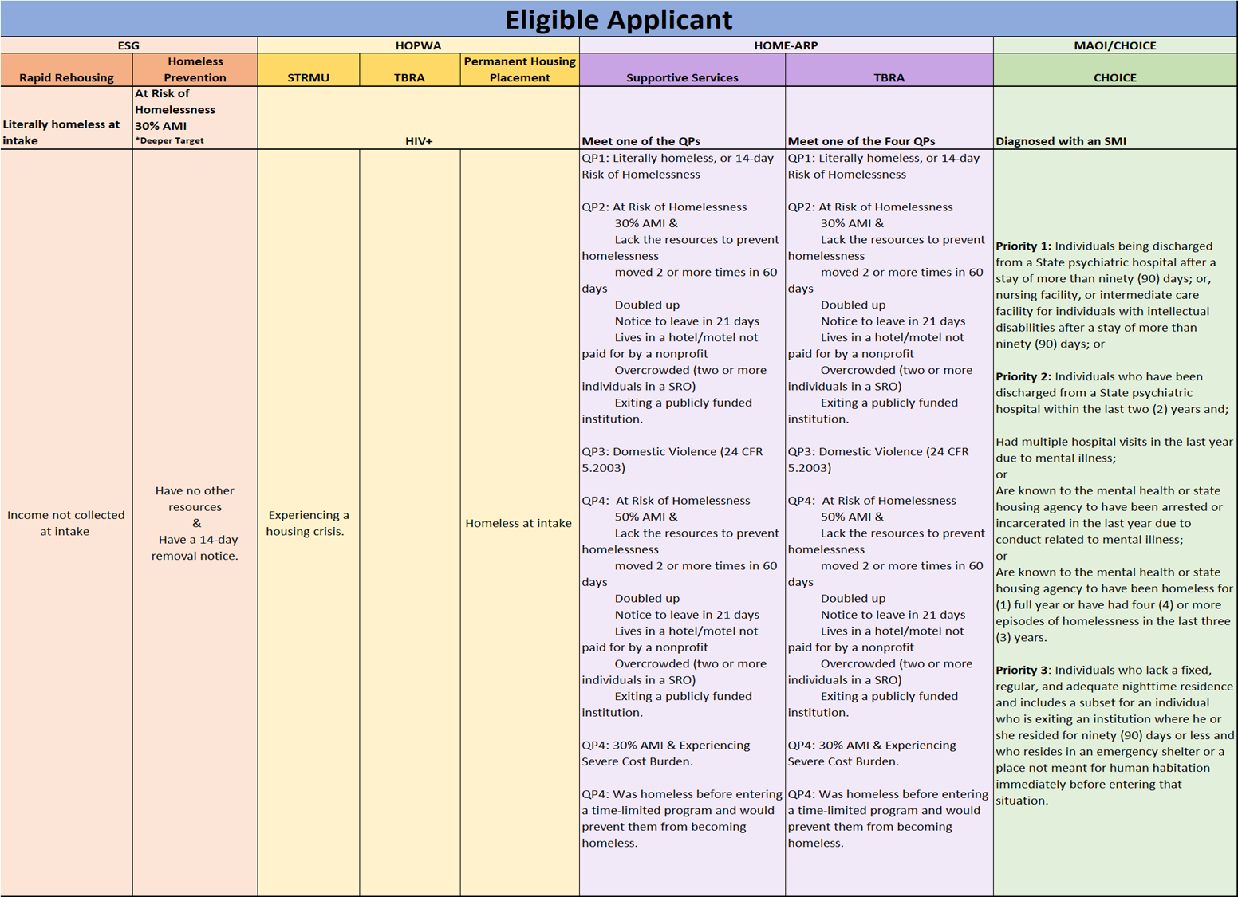

Slide 29
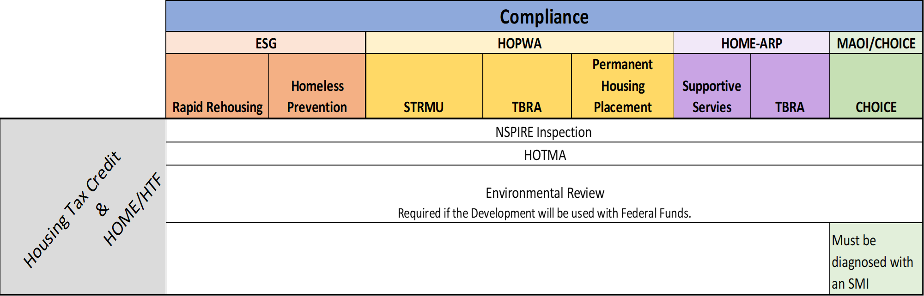
Notes:
Notes:
Program compliance is based on HUD's program regulations and MHC's program requirements. Updates to the federal regulations or MHC's requirements may impact compliance.

Slide 30

Now that we see how the programs overlap, let's consider what that means and its impact.

Slide 31
Housing Development and Housing Services Programs
Supportive Services & TBRA

Slide 32
Rental Development Challenges
Difficulty locating targeted population.
Concerns about occupancy due to income.
Tenants may lack access to critical resources or support services.

Slide 33
Rental Development Challenges
Challenge: Most homeless and 30% AMI households are unable to pay sufficient rent to cover debt service & other operating costs
Project-based rental assistance (PBRA)/Master Leasing is an option (HOME-ARP) (HOPWA)
Other techniques to ensure sustainable projects include
  Mixed-income developments
  LIHTC
Flexibility layering addresses challenges and creates sustainable projects
  HOME-ARP
  HOME/HTF
  HOPWA

Slide 34
TBRA, ESG and Rental Development
Rental subsidy is an allowable activity through HOME-ARP, HOPWA and ESG.
  HOME-ARP and HOPWA= TBRA
  ESG= Rental assistance
TBRA can be used on units developed through HOME, HOME-ARP and Tax Credit to subsidize the rent.
  TBRA is not a stationary voucher but is portable and can move with the applicant.
ESG can pay for rent and rental arrears of qualified individuals for up to 24 months.

Slide 35
Supportive Services
Financial assistance
(rental & utility)
Employment services, job training
Education services
Life skills
Food costs
Transportation
Rent & Utility
Legal services
Case Management
Outreach

Slide 36
Rental Development with Services
Challenge: Difficulty locating eligible extremely low-income or homeless tenants.
Solution: Partner with housing support agencies that can screen and refer appropriate tenants to your property.
Challenge: Concerns about filling units due to tenant income limitations.
Solution:
TBRA can help by providing:
Portable vouchers
Master leasing / Project-Based Rental Assistance (PBRA)
ESG can also offer rental assistance and supportive services.
Challenge: Tenants may lack access to critical resources or support services.
Solution: Connect tenants with housing service providers that offer:
Case management
Life skills training
Employment support
Other wraparound services

Slide 37
Advantages of Partnering with Housing Service Program
Better resident stability
  Access to supportive services
Access to target populations
Risk management
Greater community impact

Slide 38
Partnering with Housing Supportive Services
Are you currently partnering with local Housing or Community Supportive Service Providers?
  YES
  NO

Slide 39
Partnering Agencies

Slide 41
MHC Housing Providers Agencies

Slide 42
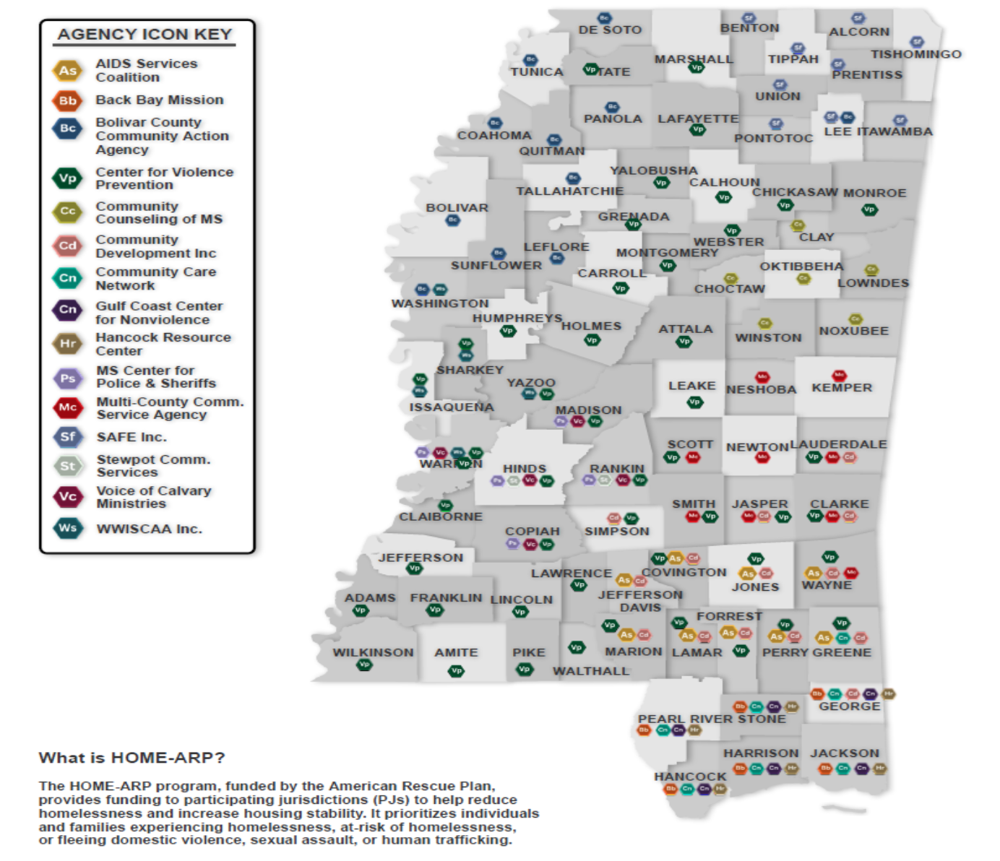
HOME-ARP

Slide 43
ESG

Slide 44

Partnering with Housing Supportive Services
Survey
Survey Questions!

Slide 45
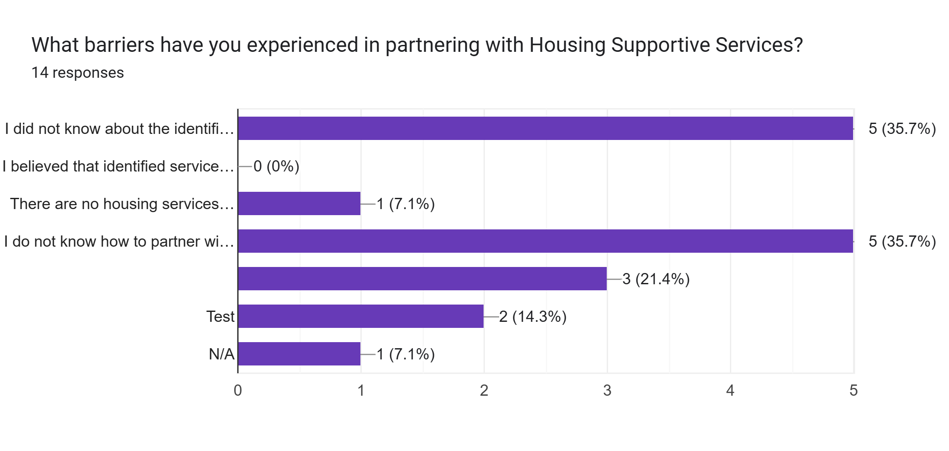
https://docs.google.com/forms/d/1LP-1JHDmS2neo_hrXbgbTzs1NGVcGssx60CFhputals/edit#responses

Slide 46
Forms

Slide 47
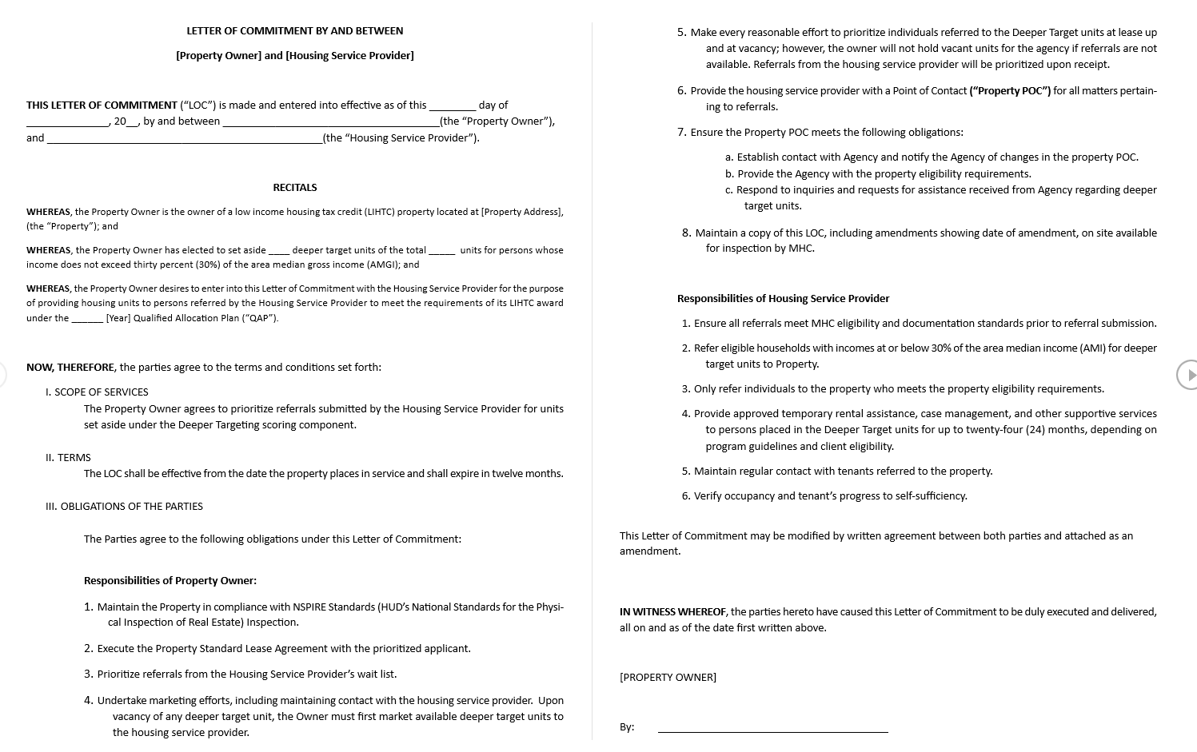

Slide 48
Responsibilities of the developer/property manager
  Each property must:
  Designate a Property Point of Contact (POC) responsible for coordination with the Housing Service Provider.
    The POC must notify both MHC and the provider within ten business days of any personnel change
  Provide HP with all property eligibility requirements
  Respond to HP inquiries and maintain clear communication with the service agency regarding unit availability and referral status.
  Maintain a signed copy of the Letter of Commitment, including any amendments, on site at all times.

Slide 49
Responsibilities of the Housing Provider (HP)
  MHC-approved Housing Providers are responsible for the following:
  Referring eligible and appropriate tenants to the Deeper Target units.
  Ensuring that individuals referred to Deeper Target units have incomes at or below thirty percent (30%) of the Area Median Income.
  Verifying that referred households meet all property eligibility requirements.
  Providing needed eligible services. For example, temporary rental assistance, case management, and supportive services for up to twenty-four (24) months in accordance with program guidelines and client eligibility.
    Financial assistance cannot be provided to units that are already subsidized by the Housing Authority (HA).
  Maintaining regular contact with tenants, monitoring their progress toward housing stability and self-sufficiency, and documenting occupancy, case notes, and program outcomes.

Slide 50
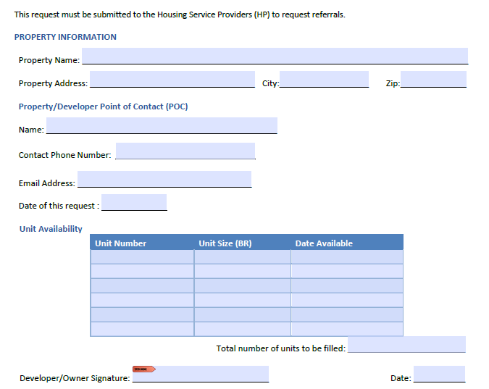
Getting the Referrals
  The Property Point of Contact (POC) must notify the Housing Service Provider(HP) when they are ready to start identifying tenants for the Deeper Target units.
  The POC can send the HP a request for a referral form that identifies the number of units, unit size, and the date the unit will be available.

Slide 51
Getting the Referrals
  When the HP identifies an appropriate applicant for the property, they can send a Deeper Target referral to the property.
  The referral must include an ROI, 30% AMI verification, and all property eligibility requirements.
Notes:
What came first, chicken or egg

Slide 52
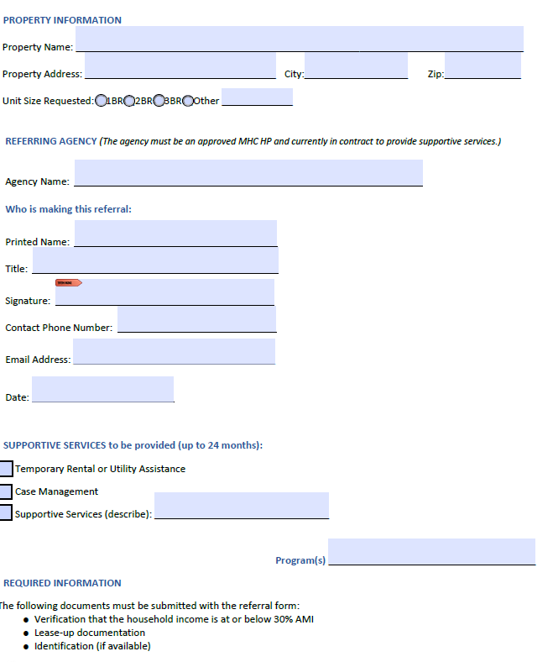
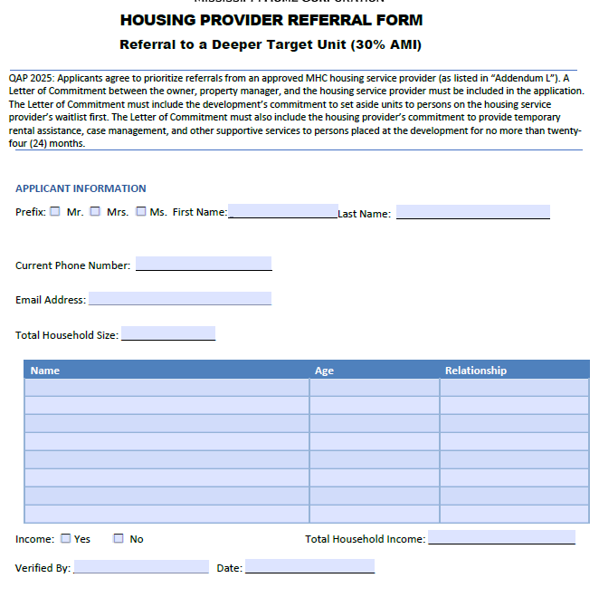

Slide 53

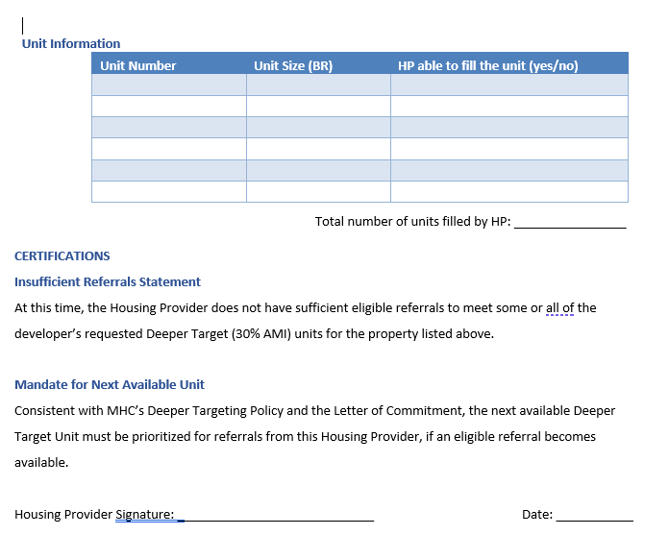
Notification of no available referrals
If the HP has no referral to meet the request, the HP will provide a Notification of No Available Referrals.
However, the next available Deeper Target Unit must be prioritized for referrals from the Housing Provider, if an eligible referral becomes available.

Slide 54
Responsibilities of the developer/property manager
  Property owners are responsible for maintaining the property in compliance with HUD’s NSPIRE standards and for keeping inspection records available for MHC review.
  Owners must execute standard lease agreements with prioritized applicants referred by the Housing Service Provider (HP) and, upon vacancy, must first market Deeper Target units to MHC-approved Housing Service Providers (HP).
  Owners are required to make every reasonable effort to lease available units to eligible referrals, but owners are not required to hold units vacant if referrals are unavailable.

Slide 55
Responsibilities of the Housing Provider (HP)
  Collect and maintain appropriate eligibility documentation
  Providing needed eligible services. For example, temporary rental assistance, case management, and supportive services for up to twenty-four (24) months in accordance with program guidelines and client eligibility.
    Financial assistance cannot be provided to units that are already subsidized by the Housing Authority (HA).
  Income Recertification Requirements
    The HP shall conduct recertification for 30% Area Median Income (AMI) households in accordance with the applicable housing program policy. The HP must provide the Developer or Property Manager with all recertification documentation and income updates.
    The income recertification conducted by the HP does not negate or replace the Developer or Property Manager’s obligation to verify and maintain current household income information as required for compliance under MHC’s program regulations.

Slide 56



Contact information:
FEDERAL GRANTS DEPARTMENT
Tamara Stewart
VP of Federal Grants Management
Tamara.stewart@mshc.com
601-718-4654

